Slide 1
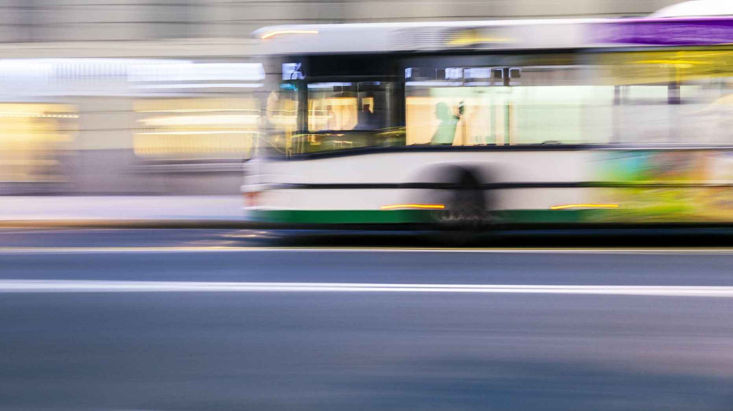
Using Intelligent Transportation Systems to Enhance Pedestrian Safety at Beirut Signalized Intersection.

Slide 2

Team Information – [Group 10]
Supriya Manda R11847461
Ajay Konkitala R11854972
Teja Potturi R11842952
Lakshmi Surya Sesha Sai Varma Manthena
R11847455
Neha Lagatapati R11856841
Nikhil Chandrareddy Desireddy R11808040

Slide 3
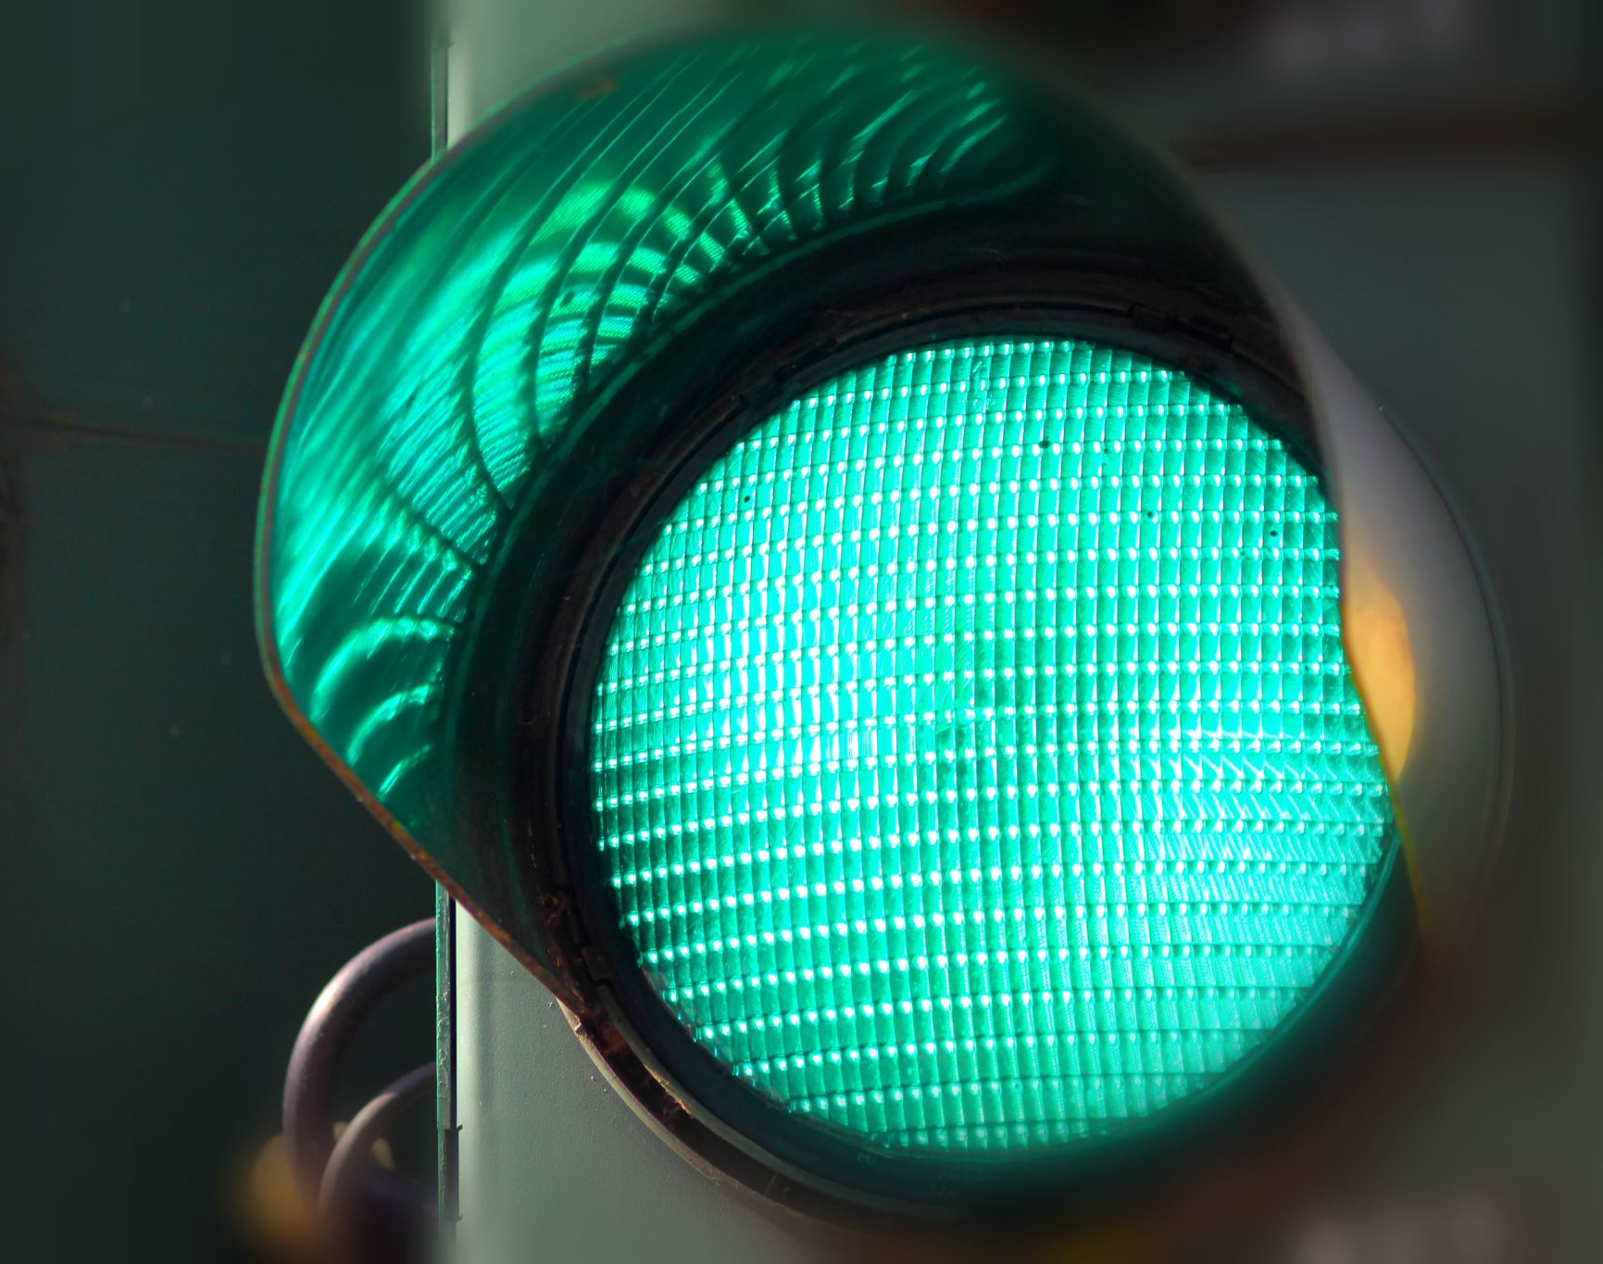
Agenda
Traffic signal Hacking and Image transfer via servers.
Reduce accidents and secure signals at the crosswalks, secure image transfer.

Slide 4
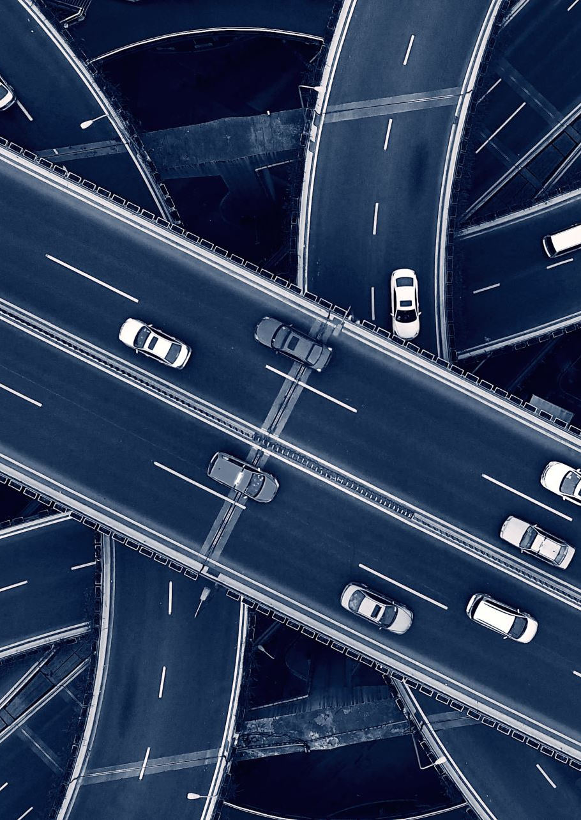
Problem Statement
The paper "Using Intelligent Transportation Systems to Enhance Pedestrian Safety at Beirut Signalized Intersection" is the study done by Rania Wehbe, Zaher Massaad and Elie Otayek. It focuses on the high percentage of pedestrian victims of road accidents at the Al-Ghazal signalized intersection in Greater Beirut Area (GBA).
This particular intersection was chosen due to lack of traffic facilities combined with high pedestrian volume, which favors the accidents of the pedestrians. Due to this, Al-Ghazal signalized intersection has been considered to be a black spot for pedestrians.
They mention the various reasons for such accidents. Some of the reasons mentioned are bad geometry concept, high traffic volumes, missing crosswalk, yield markings, no traffic signals or poor maintenance of traffic signals.

Slide 5
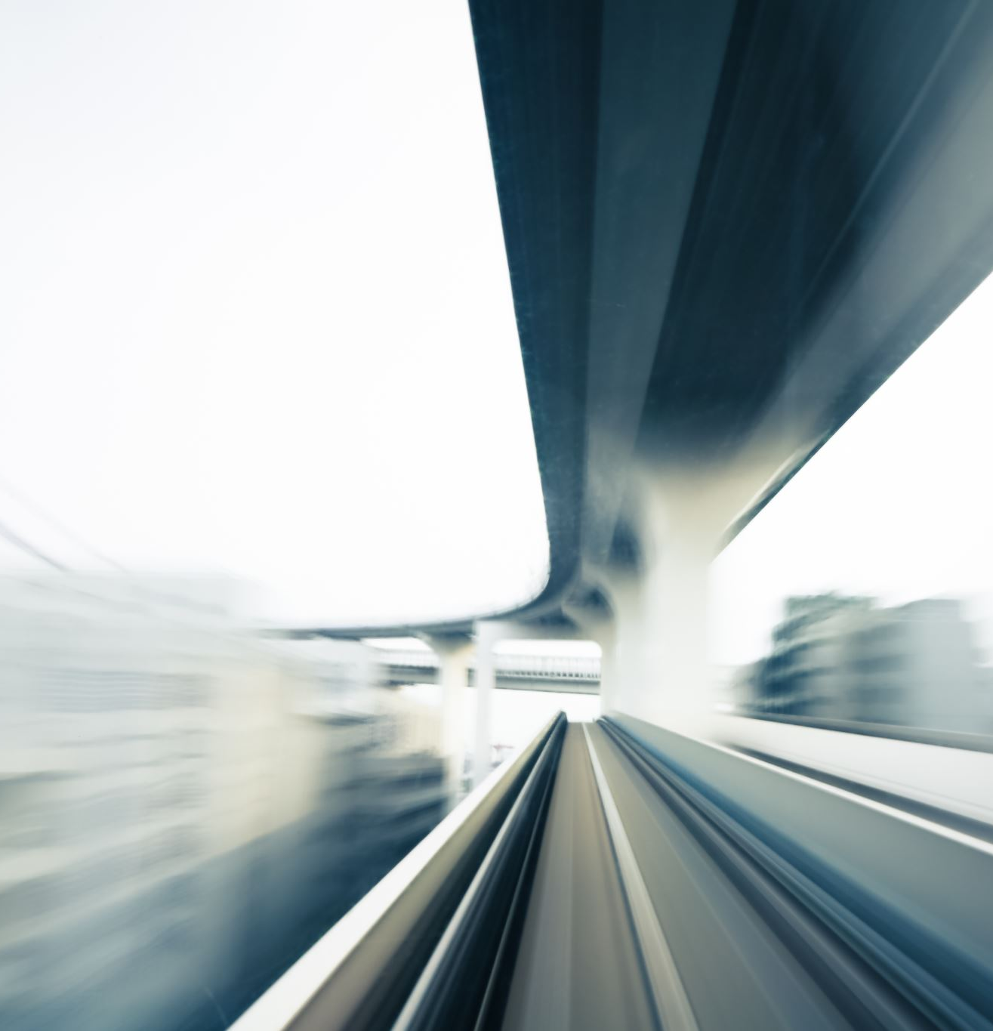
Existing Solutions
Various solution scope along with their implementation cost is mentioned in the paper theoretically. The authors state that NRSC implements the given solution analysis practically. Below are the intelligent transportation systems (ITS) solutions proposed in the paper.
At an intersection, the signals and crosswalks should be well organized.
The pedestrians should be alerted on the time remaining to cross the intersection (countdown pedestrian signal).
Automated Pedestrian Detection: This is the most advanced ITS strategy. Using this method, the presence of pedestrians is detected without their effort. This reduces around 185 to 45 accidents but has a high implementation cost (~$10,000 - $70,000) per crosswalk.

Slide 6

Proposed Solution:
The Automated Pedestrian Detection technique that is mentioned in the paper is taken as the base point for this project implementation which is cost effective.
We will be able to detect the presence of a pedestrian without any action from them through video recording at traffic signals.
If a pedestrian is detected to be waiting at the signal, the signal will change, and the walkway will be opened for the pedestrians to cross safely.
This procedure is cost effective as the cameras that are already installed to detect signal jumping will be used to implement it.
The program used in this project will be inserted into the already existing cameras.
Additionally, we will be able to detect vehicles such as cycles along with the pedestrians in this solution.
Due to this, the solution can easily be implemented at any traffic signal without high costs.
This will enhance the safety of pedestrians by reducing the fatalities.

Slide 7
Proposed Solution:
We finally decided to use the module OpenCV.
It contains Viola-Jones algorithm and the HOG (Histogram of Oriented Gradients) algorithm and is considered one of the best modules.
The main reason to choose this is its ability to train custom models along with the custom pre trained models even if the pre trained models are more than enough.
Further, we use sockets to establish a client-server connection in order to pass the message to the traffic signal. In addition to this, a time mechanism has been implemented that gives the pedestrians the time to cross without the change of signal(to green) until he is no longer detected.
Once the pedestrian is no longer detected, the signal changes and allows the vehicles further.

Slide 8
System Requirements
Software Requirements
Hardware Requirements
Models/ Modules that were used.
OpenCV (OpenSource Computer Vision Library)
Sockets
Language used : Python
Camera

Slide 9
Software Architecture Design
Start
Video Stream from Live Cameras
Image Save
Image-Split to Frames
Image Detection
If detects person
YES
NO
If detects Car crossing during RED signal
NO
YES
Put a rectangle box on the person

Slide 10
Threat Model
Unauthorized access: If the system used to identify cars and pedestrians is not properly secured, an attacker could gain unauthorized access to the system, potentially compromising sensitive data or tampering with the system's operation.
False positives/negatives: The system may incorrectly identify a car or pedestrian, leading to a false positive or negative result. This could cause traffic delays or accidents if traffic lights are not properly controlled.
Data privacy: The images captured by the system could contain sensitive information, such as license plate numbers or personal identifying features of pedestrians. Appropriate measures must be taken to ensure that this data is properly secured and not misused.
System availability: If the system experiences downtime or is otherwise unavailable, it could lead to traffic disruptions or accidents.
Malicious activity: The system could be targeted by an attacker who intentionally causes traffic disruptions or accidents by exploiting vulnerabilities in the system.

Slide 11
Threat Model
To mitigate these risks, we could consider implementing security controls such as encryption of data, access controls, monitoring and alerting, and regular security testing and audits. We could also implement redundancy and failover measures to ensure system availability in the event of a failure or outage

Slide 12
Results (Output)
Using the model, the main aim of the project is achieved.
The model is able to detect the pedestrians and send the images to the (Server / Client)
Image encryption is being done to provide security from attackers.
<Image oof output>

Slide 13
Pros and Cons
Pros:
Cons:
Reduced Pedestrian Accidents
Secure signal data
Image encryption is an advantage to the model
Cost effective
More waiting time for the vehicles

Slide 14
Issues and Solutions
Issues:
Testing model using correct images.
Finding appropriate dataset to train the model.
Sending encrypted images over the local network.
Solutions:
Used pedestrian images for testing.
Used online pre trained model for detection of people.

Slide 15
Conclusion
High percentage of pedestrians are victims of road accidents.
This model serves the solution to reduce the pedestrian fatalities in an efficient way compared to the existing solutions.
The model is built using python programming. Using image detection, the model detects the pedestrians and cars.
Image encryption is done to provide security of the images when sent from client to server.
This gives the pedestrians a safe environment to cross the intersections.

Slide 16
Future Scope
Currently using the model, we are able to detect the pedestrian waiting to cross the road.
Along with this the model is able to detect if a car is attempting to cross the road when the signal shows red light.
This can be further developed by adding the features to detect and change the signals based on the vehicle count.
The model can be further trained based on the frequency of the vehicles and pedestrians.
When these advanced features are implemented in the model, it will help to reduce vehicle congestion on road along with focus on pedestrian safety for road crossing.
Once the testing and training of the model with mentioned advanced features in future scope is achieved, the model can be implemented in the real world pedestrians problems.

Slide 17

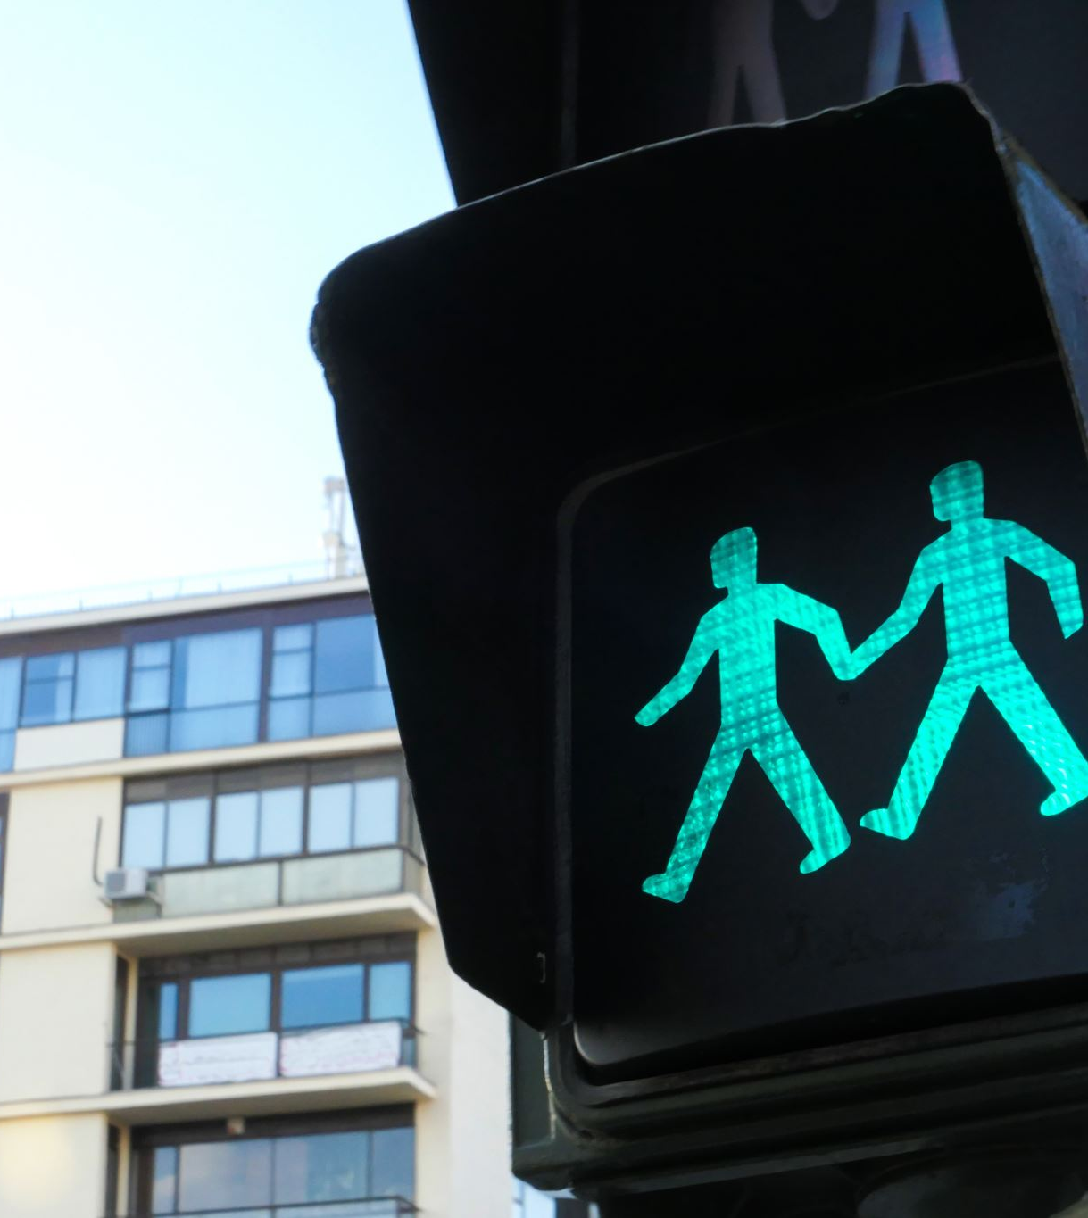
References
IEEE paper “Using Intelligent Transportation Systems to Enhance Pedestrian Safety at Beirut Signalized Intersection.”

Slide 18

Thank You.!

